Slide 1
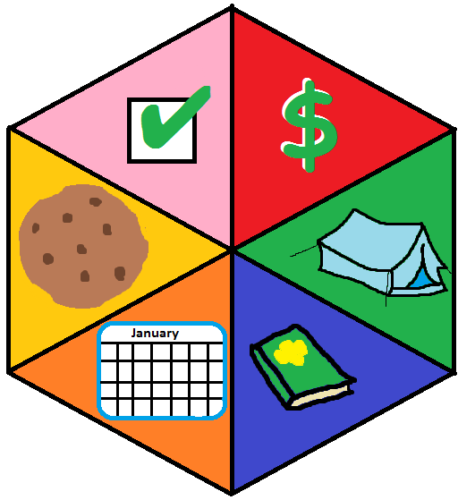
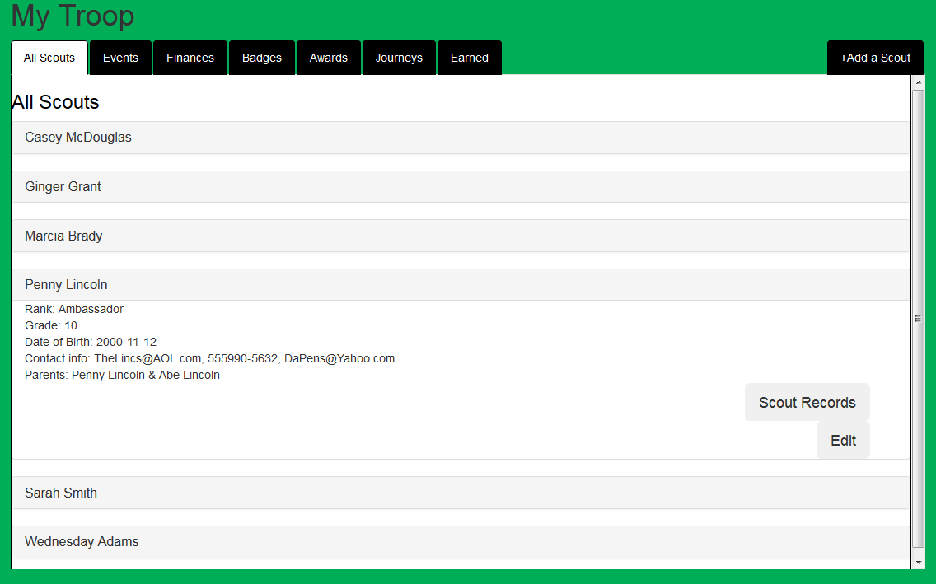

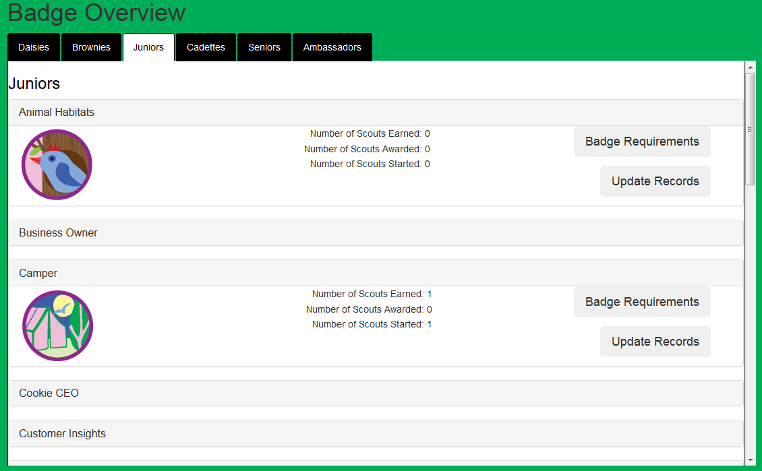




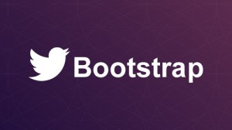

Girl Scout Badge Tracker
Matt Eck(DM),Mike Glosecki(QC),Nate Martz(OP),Ryan Schroeder(SM)
Client: Jennifer Melton, GSA
Description:
Web-based application to track Troop:
Badges, Journeys, and Bridging requirements
Finances
Events
Awards
Scout information
My Troop: displays all scouts within troop associated with authorized user and displays an overview of troop information/accomplishments.
Scout Records: displays all badges, awards events and finances related to a specific scout.
Semi-Agile process:
A Scrum-like process with ten two-week sprints
580 estimated hours
Tools
Exit Strategy
Fall 2015: basic webpages built with DB interactions, and a Database with all domain info loaded.
Spring 2016: fully implemented product
Badge Overview/Update: lists all badges available to the scouts organized by rank. The user may update completed requirements.
Shopping List: creates a shopping list of all the badges the leader should purchase from the scout shop based on badges earned.
Team Role Abbreviations: SM – Scrum Master, OP – Owner Proxy, QC – Quality Control, DM – Database Manager

